Slide 1
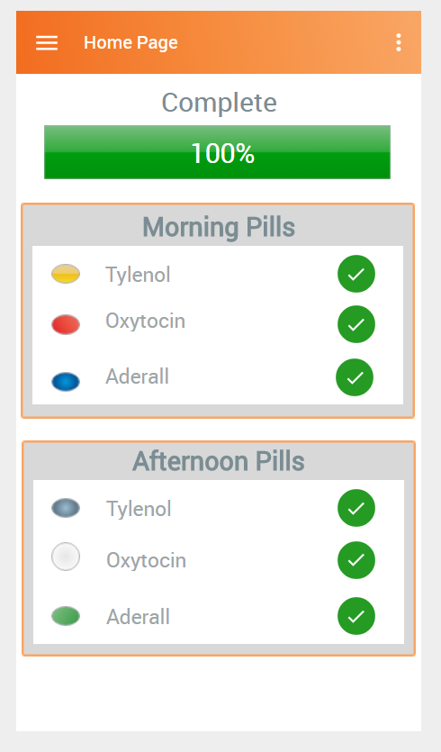

Future Developments for Adherence App
By Ryan Feng
Confidential property of Optum. Do not distribute or reproduce without express permission from Optum.

Slide 2
Summary of Future Plans
Add pill icon selection
Add pill icons to home screen
Optimize colors (red-green) to enhance user success
Try a timeline based home screen
Try a navigation bar instead of a hamburger menu
Confidential property of Optum. Do not distribute or reproduce without express permission from Optum.

Slide 3
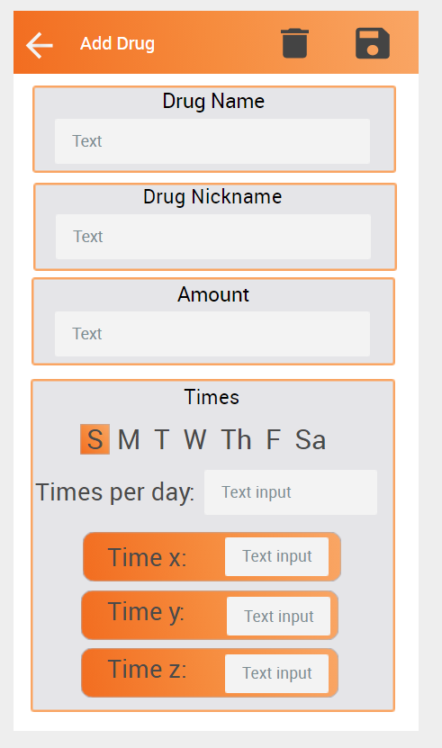
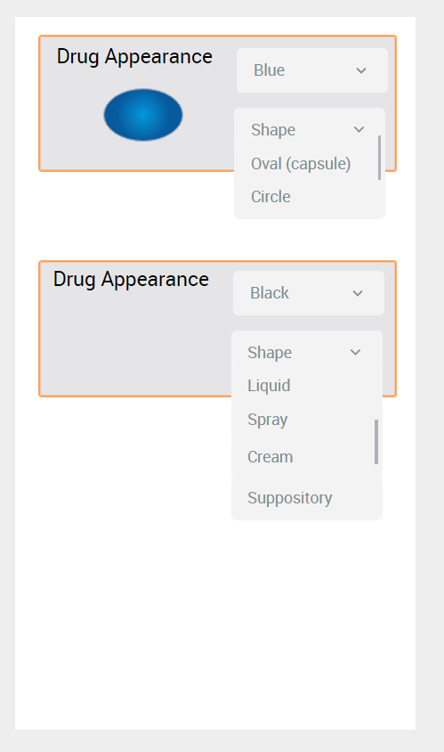
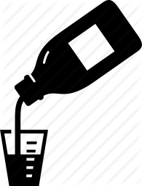
Pill Color and Shape Icon
-The app will let users specify the shape and color of the pill they’re taking.
-This ensures users can physically recognize their meds.
-The possible medication icons range from pills to liquids to sprays and etc.

Slide 4
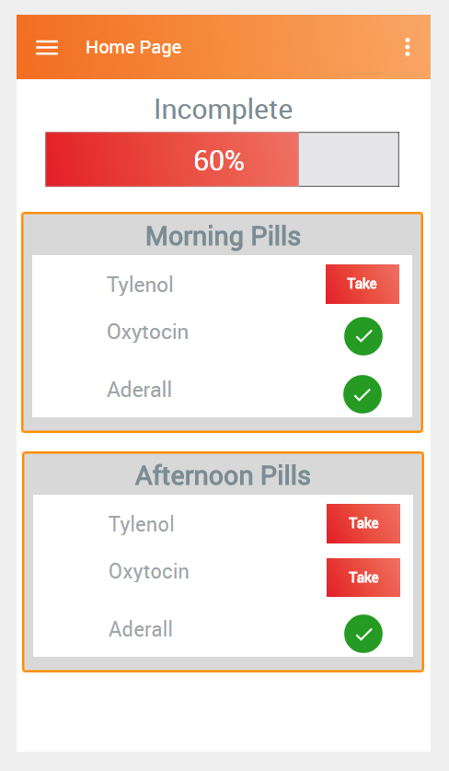
Revised Home Page w/ Pill Appearance
-Progress bar turns green when user takes all the drugs.
-This creates a subconscious desire to make the bar turn green, ensuring the user wants to take his/her drugs.
-Pill icons on the home screen help users discern their meds.

Slide 5
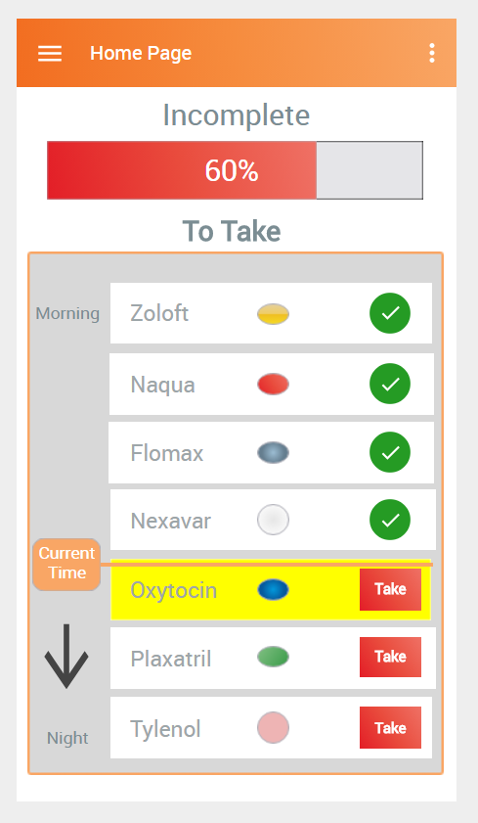
Time-flow home page
In this proposed home screen, the “Current Time” orange bar moves down the list of drugs sequentially.
The drug to be taken now will flash yellow.
Users will be able to better understand when they have to take their drugs.

Slide 6
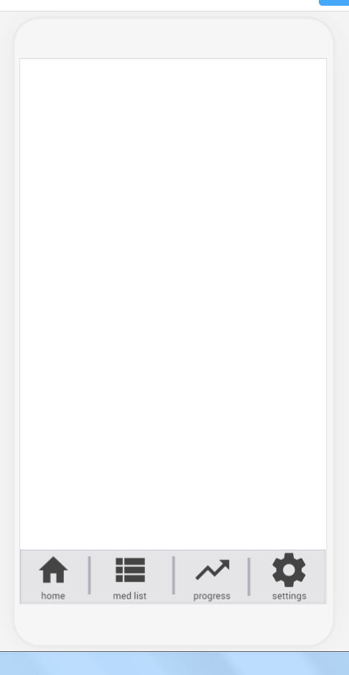
Navigation Bar
A navigation bar is easier to use instead of a hamburger drop down menu.
Menu buttons will have titles to help older people navigate the app easier.

Slide 7
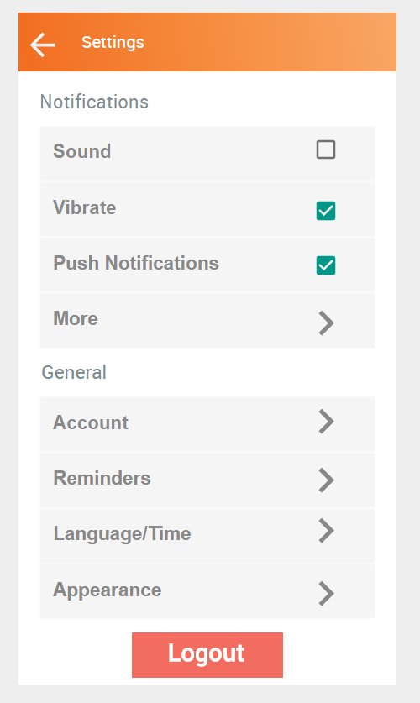
Settings Page
Important notification toggles are front and center.
Settings layout will be sorted by most used settings at the top.

Slide 8
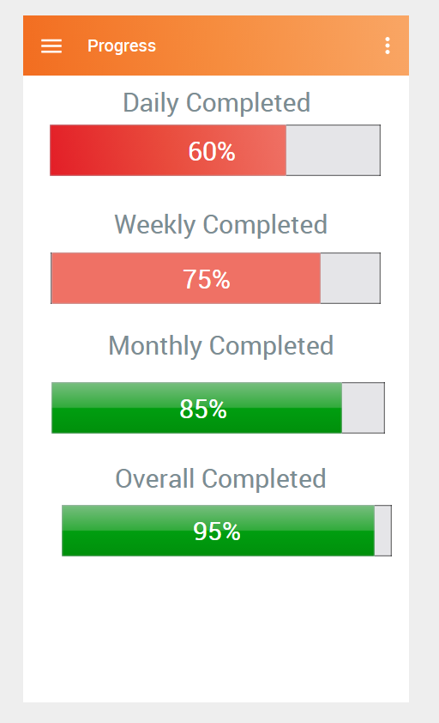
Overall Progress Bar
Home Screen -> Progress Button -> Progress Screen
Find the best way to visualize long term and short term medication goals.

